Slide 1
ISA5577 Applied Quantitative Methods for Human-Computer Interaction
人機互動量化研究方法
May 4, 2015
Hao-Chuan Wang

Slide 2
Today’s Agenda
How to report your results in the form of a paper
Applied machine learning introduction
Regression analysis
Sources & Content Credits:
Scott MacKenize http://www.yorku.ca/mack/CourseNotes.ppt
Carolyn Penstein Rosé- Machine Learning in Practice: http://www.cs.cmu.edu/
~cprose/MachineLearningInPractice.html
All materials are obtained from the internet and reused under the term of fair use for
the sole purpose of education.

Slide 3
Steps in Empirical Research (1)
Phase I – The Prototype
Steps 1-3 (previous slide)
Think, Analyse,
Model, Create, Choose, etc.
Build Prototype
Test,
Measure,
Compare
Short paper, Poster,
Abstract
Iterations are frequent, unstructured, intuitive, informed, …

Slide 4
Steps in Empirical Research (2)
Phase II – The User Study
Build Apparatus
(integrate prototype and test conditions into experimental apparatus & software)
Experiment Design
(tweak software, establish experimental variables, procedure, design, run pilot subjects)
User Study (collect data, conduct interviews)
Analyse Data
(build models, check for significant differences, etc.)
Publish Results
Next iteration

Slide 5
Research Paper
The final step
Research is not finished until the results are published!

Slide 6
Organization of a Research Paper
Title
Abstract
Body
Main sections…
Introduction
Method
  Participants
  Apparatus
  Procedure
  Design
Results and Discussion
Conclusions
Formatted according to submission requirements of conference or journal (e.g., view the template for CHI submissions http://www.sigchi.org/publications/chipubform/ ).

Slide 7
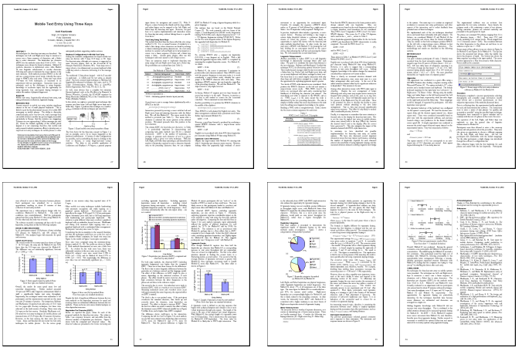
Example Publication†
† MacKenzie, I. S. (2002). Mobile text entry using three keys. Proceedings of NordiCHI 2002, 27-34. New York: ACM.

Slide 8
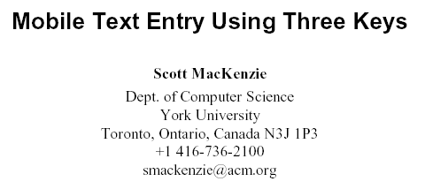
Title, Author(s), Affiliation(s)
Title
Every word tells

Slide 9
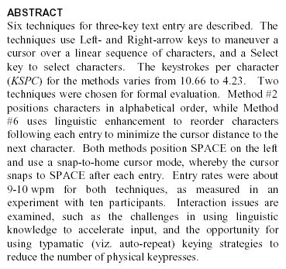
Abstract
Abstract
Write last
Not an introduction!
State what you did and what you found!
Give the most salient finding(s).

Slide 10

Keywords
Keywords
Used for database indexing and searching.
Use ACM classification scheme (for ACM publications)..

Slide 11
Introduction
Introduction
Give the context for the research, stating why it is interesting and relevant.
Ex. Identify a UI problem or challenge as it currently exists.
Give an overview of the contents of the entire paper.
Identify, describe, cite related work.
Describe and justify your approach to the problem.
Follow the formatting requirements of conference or journal.
It’s your story to tell!

Slide 12
Method
Method
Tell the reader what you did and how you did it.
The research must be reproducible!
Use the following subsections…

Slide 13
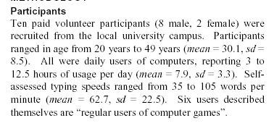
Method - Participants
Participants
State the number of participants and how they were selected.
Give demographic information, such as age, gender, relevant experience.
Note: The term “Subjects” is now obsolete.

Slide 14
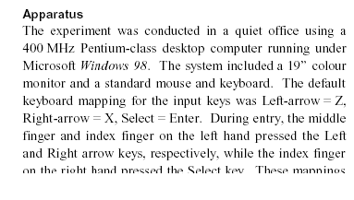
Method - Apparatus
Apparatus
Describe the hardware and software.
Use screen snaps or photos, if helpful

Slide 15
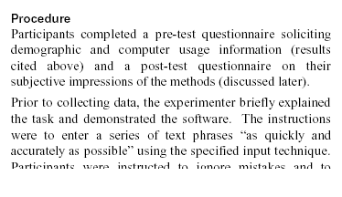
Method - Procedure
Procedure
Specify exactly what happened with each participant.
State the instructions given, and indicate if demonstration or practice was used, etc.

Slide 16
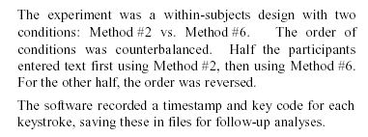
Method - Design
Design
Give the independent variables (factors and levels) and dependent variables (measures and units).
State the order of administering conditions, etc.
Be thorough and clear! It’s important that your research is reproducible.

Slide 17
Results and Discussion
Results and Discussion
Use subsections as appropriate
If there were outliers or problems in the data collection, state this up-front.
Organize results by the dependent measures, moving from overall means to finer details across conditions.
Use statistical tests, charts, tables, as appropriate

Slide 18
Results and Discussion (2)
Don’t overdo it! Giving too many charts or too much data means you can’t distinguish what is important from what is not important.
Discuss the results. State what is interesting
Explain the differences across conditions.
Compare with results from other studies.
Provide additional analysis, as appropriate, such as fine grain analyses on types of errors or linear regression or correlation analyses for models of interaction (such as Fitts’ law).

Slide 19
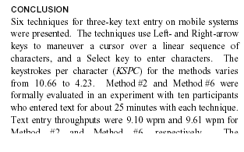
Conclusion
Conclusion
Summarize what you did.
Restate the important findings.
State (or restate) the contribution.
Identify topics for future work.
Do not develop any new ideas in the conclusion.

Slide 20

Acknowledgment
Acknowledgment
Thank people who helped with the research
Thank funding agencies

Slide 21
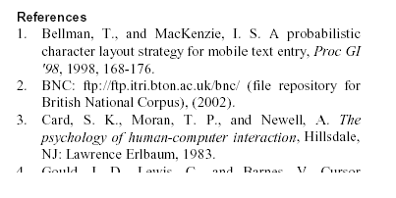
References
References
Include a list of references, formatted as per the submission requirements of the conference or journal
Only include items cited in the body of the paper..

Slide 22
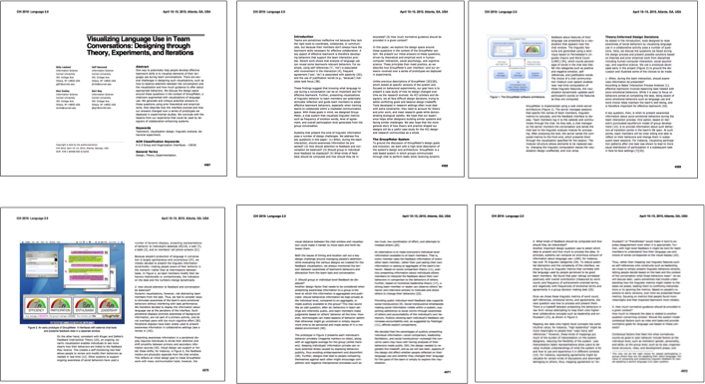
CHI Extended Abstract
e.g., Leshed, G., et al (2010). Visualizing language use in team conversations: designing through
theory, experiments, and iterations http://dl.acm.org/citation.cfm?doid=1753846.1754195

Slide 23
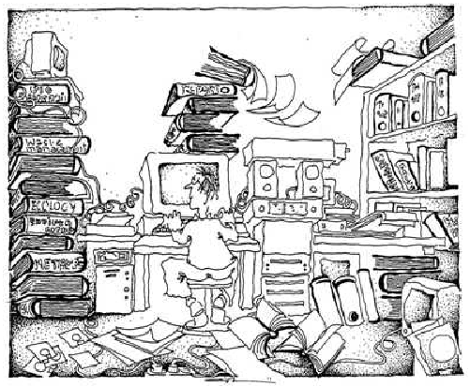
Why Machine Learning? Overwhelmed with data…
Demographic statistics
Credit history
Clinical trials
Geological data
Sales information
Movie ratings
www.powerfulinformation.org

Slide 24
What do we do with all of it?
Machine learning is about
systematically finding meaningful
patterns in data
Example for credit history data:
Rule predicts who is more likely to have problems
paying off credit.

Slide 25
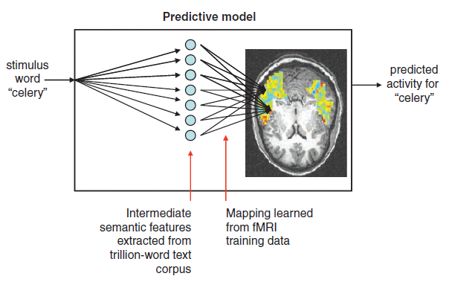
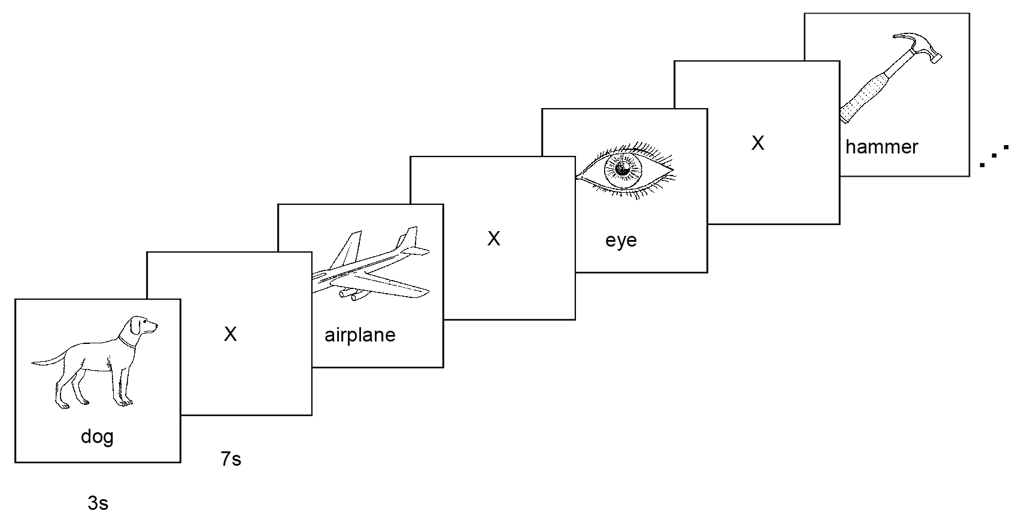
Machine Learning in Practice
– Mind Reading
Predicting Human Brain Activity Associated with the Meanings of Nouns (Mitchell et al., 2008)
  In an object-contemplation task, participants were presented with 60 objects and were instructed to think of the same properties of the stimulus object consistently while being scanned by fMRI machines.
  Given the evoked neural activity signatures evoked, we can correctly guess what the participants were thinking 70% of the time!
7s
X
celery
3s
X
ant
time
refrigerator

Slide 26


Machine learning example….
Processing conversational data
Student1: I don’t
understand what to
do next.
Student2: Let me do it.
Support Agent: Student2,
it looks like your partner
could use some help.
Help
Time

Slide 27
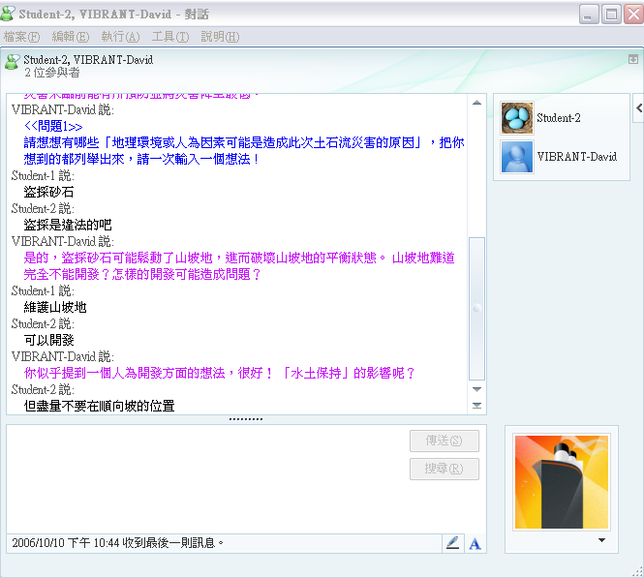
Triggering feedback for collaborative idea generation…
Speaker | Text
Student 1 | People stole sand and stones to use for construction.
FEEDBACK AGENT | Yes, steeling sand and stones may destroy the balance and thus make mountain areas unstable. Thinking about development of mountain areas, can you think of a kind of development that may cause a problem?
Student 2 | Development of mountain areas often causes problems.
Student 1 | It is okay to develop, but there must be some constraints.

Slide 28
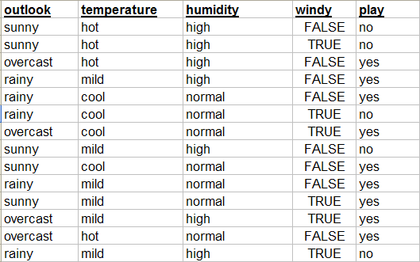
How does machine learning work?

Slide 29
How does machine learning work?
The simplest rule learner will
learn to predict whatever is
the most frequent result class.
This is called the “Majority
Class”.
What will the rule be in this case?
It will always predict yes.

Slide 30
How does machine learning work?
A slightly more sophisticated rule learner
will find the feature that gives the most
information about the result class. What
do you think that would be in this case?
Outlook:
Sunny -> No
Overcast -> Yes
Rainy-> Yes
<Feature Name>:
<value> -> <prediction>
<value> -> <prediction>
…

Slide 31
What is machine learning?
Automatically or semi-automatically
  Inducing concepts (i.e., rules) from data
  Finding patterns in data
  Explaining data
  Making predictions
Data
Learning Algorithm
Model
Classification Engine
Prediction
New Data

Slide 32
What will be the prediction?
Model
Outlook:
Sunny -> No
Overcast -> Yes
Rainy-> Yes
New Data
Yes

Slide 33
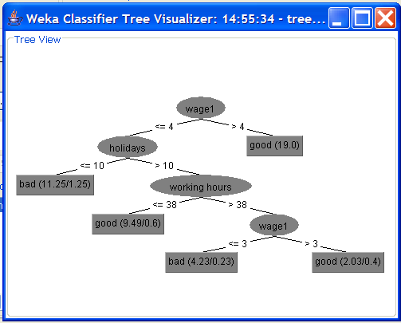
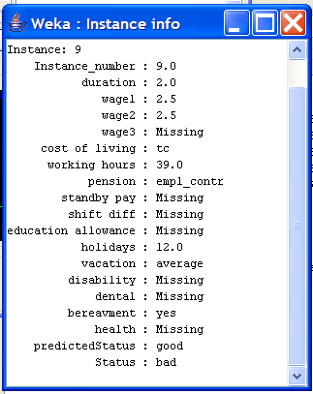
Terminology
Concept: the rule/model you want to learn
Instance: one data point from your training or testing data (row in table)
Attribute: one of the features that an instance is composed of (column in table)
* Compute the predicted value.

Slide 34
Styles of Learning
Classification (“supervised learning”) – learn rules/models from labeled instances that allow you to assign new instances to a class
Association – look for relationships between features, not just rules that predict a class from an instance (more general)
Clustering (“unsupervised learning”) – look for instances that are similar (involves comparisons of multiple features)
Numeric Prediction (regression)
We’ll start from regression models, and then talk about classification.

Slide 35
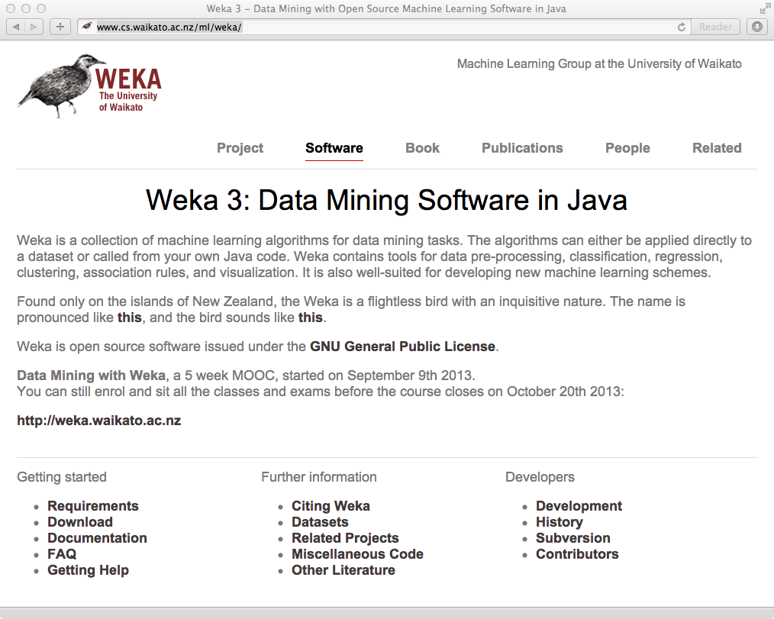
http://www.cs.waikato.ac.nz/ml/weka/

Slide 36
Linear Regression
Regression analysis finds the equation of the line that best describes the relationship between two (or more) variables (e.g., y and x).
  Conventionally, we call y the predicted variable, and x_{n} the “predictors” or predicting variables.
One use of this equation: to make numeric predictions.

Slide 37
Models or prediction equations:
Some examples of various possible relationships.
Linear:
Quadratic:
Exponential:
Logarithmic:
Note: What would a scatter diagram look like to suggest each relationship?

Slide 38
Method of least squares:
Equation of the best-fitting line:
Predicted value:
Least squares criterion:
Find the constants b₀ and b₁ such that the sum
is as small as possible.

Slide 39
Observed and predicted values of y:

Slide 40
The equation of the line of best fit:
Determined by
b₀: slope
b₁: y-intercept
Values that satisfy the least squares criterion:
Proof of least square method:
http://www.cc.ntut.edu.tw/~jsechang/jsechang3/method/Least_squares.pdf

Slide 41
Example: A recent article measured the job satisfaction of subjects with a 14-question survey. The data below represents the job satisfaction scores, y, and the salaries, x, for a sample of similar individuals.
1. Draw a scatter diagram for this data.
2. Find the equation of the line of best fit.

Slide 42
Preliminary calculations needed to find b₁ and b₀:

Slide 43
Finding b₁ and b₀:

Slide 44
Scatter diagram:

Slide 45
Note:
The slope b₁ represents the predicted change in y per unit increase in x.
The y-intercept is the value of y where the line of best fit intersects the y-axis.
The line of best fit will always pass through the point

Slide 46
Making predictions:
1. One of the main purposes for obtaining a regression equation is for making predictions.
2. For a given value of x, we can predict a value of y,
The regression equation should be used to make predictions only about the population from which the sample was drawn.
4. Use current data. A sample taken in 1987 may or may not be feasible data used for making predictions in 1999.

